Slide 1
An Exploratory Analysis of the effects of the COVID-19 Pandemic in the United States
Spencer Marlen-Starr
STAT 515: Applied Statistics and Visualization for Analytics
December 6th, 2020

Slide 2

Decision to limit the scope of the project
Because I chose such a broad topic, I decided to limit my analysis to just looking at data on deaths. I did not explore data on cases, tests, hospital capacity, or anything else for that matter.

Slide 3
Overview
I start by exploring the excess deaths in the United States
Then I will do some local international comparisons
The graphical section will end with some interstate comparisons
The presentation closes with a statistical learning model & analysis

Slide 4

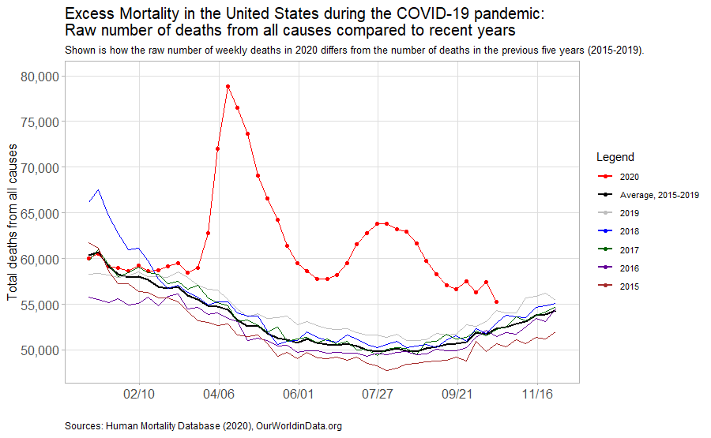
Part 1: Looking at excess mortality

Slide 5
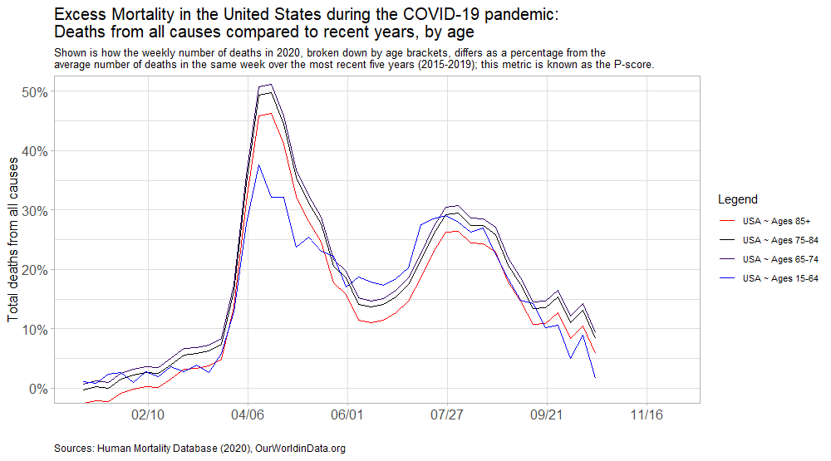
Investigating how big of a role age has played

Slide 6
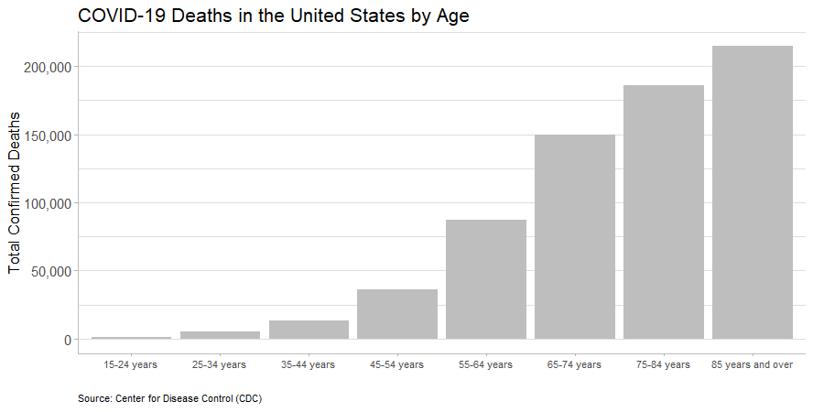
Exploring the age factor further

Slide 7
Part 2: A brief look at the effects of COVID-19 in the United States compared other countries in North America

Slide 8
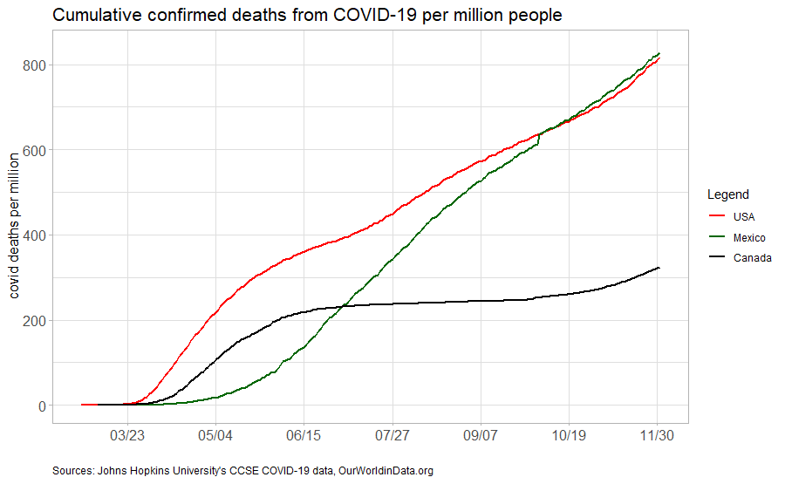
Comparing the total confirmed Covid deaths per million in the United States to that of its two closest neighbors

Slide 9
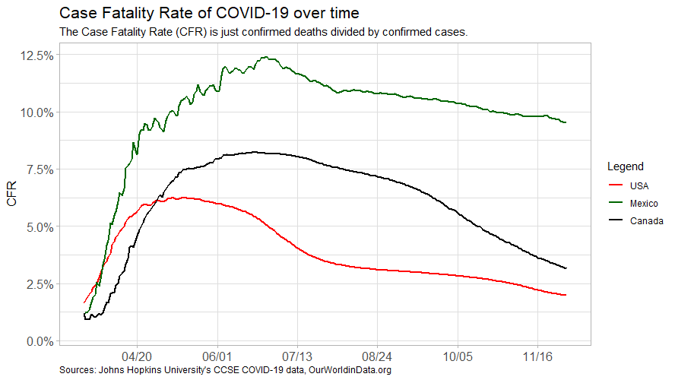
Taking a look at the dynamics of the case fatality rates of the United States, Mexico, and Canada

Slide 10
Part 3: Interstate comparisons of Covid outcomes

Slide 11

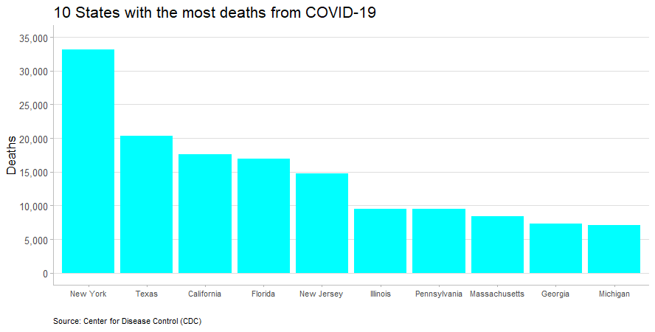
Graphically answering the question of which states have been hit hardest in terms of total deaths so far

Slide 12
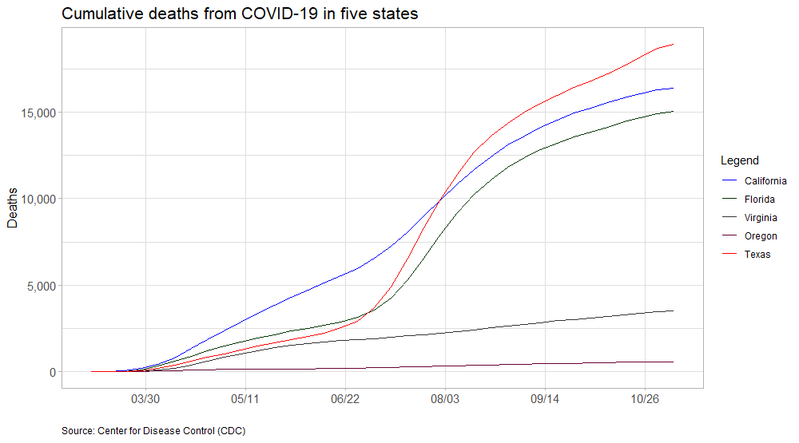
Comparing a handful of states which have had different public policy approaches

Slide 13
Part 4: The statistical learning model
Because we have just seen such a jungle of loosely related information in the previous graphs, we are going to need a forest’s worth of statistical learning firepower to make sense of it, that is why I chose to use random forest regression.

Slide 14
What I did
I ran a random forest regression to try to predict total deaths in a country using a large number of variables in the same international covid dataset I used to create the international comparison graphs earlier in the presentation.

Slide 15
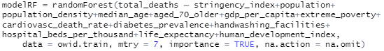
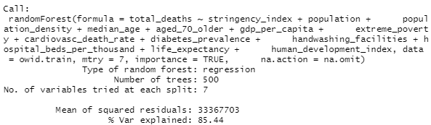
Specifying and training my random forest regression model
I decided to go with a 70/30 split for my training and testing datasets.
I also decided to stick with the default of 500 trees.

Slide 16
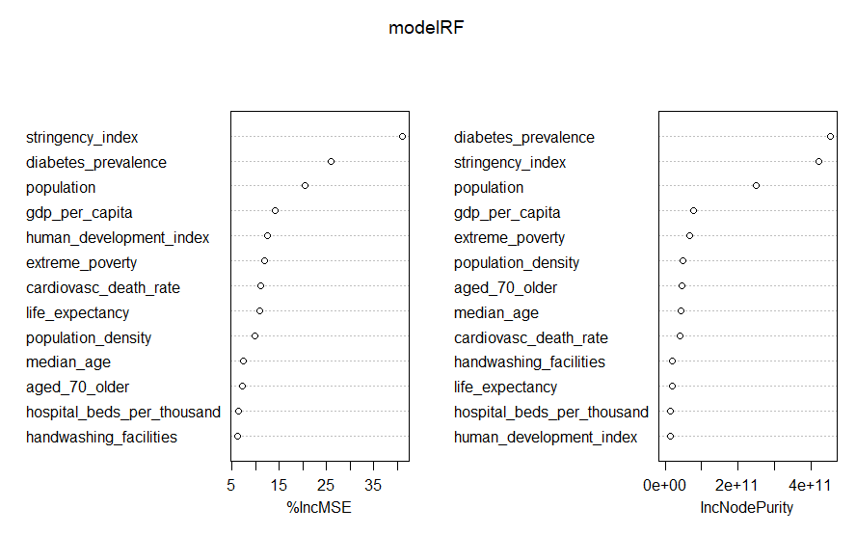
The variable importance plot

Slide 17
R packages used
tidyverse
tidyr
ggplot2
lubridate
randomForest
class
scales
caTools

Slide 18
Noteworthy hassles encountered
2 weeks ago, at the end of module 5, when I typed my discussion post sharing the datasets I said I planned to use to complete my final project, I only included 2 datasets in it.
In order to create all the graphs you saw in this presentation, I had to use 5 different datasets and do some amount of data cleaning and pre-processing on all of them.

Slide 19
The End
Thank you for listening!

Slide 20
References and Sources
Dataset sources:
The Centers for Disease Control and Prevention, cdc.gov
Our World In Data, ourworldindata.org
Code:
G. James, D. Witten, T. Hastie, R. Tibshirani (2017). An Introduction to Statistical Learning - with Applications in R

